Slide 1

Securely Managing your Credentials in an Automated, Repeatable Fashion
London March 22nd 2018
@LONPSUG

Slide 2
WhoamI
Ryan Yates – Cloud & Datacentre Management MVP
One of the Co-ordinating leads for all UK PowerShell User Groups
Systems Administrator @ dotmailer – Security and Automaton are my IT passions
@ryanyates1990
Ex-SharePoint Admin

Slide 3
State Of play
All orgs have Credentials that are the “Keys to the Kingdom”
Security is typically a “last thought” especially in startup culture due to quick spurt growth
Security Breaches can instantly destroy companies due to regulation fines
Consumers loose confidence in the organisation even if it doesn’t go under

Slide 4
So what can we do?
Firstly you need to get some understanding of Red Teaming and Blue teaming and what the initial principles behind the
Some Sessions on both are available on the PSConfEU Youtube Channel – Highly recommend watching them!
People to follow include @harmjoy @jaredcatkinson @mattifestation @jepayneMSFT @PyroTek3

Slide 5
Attack Toolkits
Bloodhound - https://github.com/BloodHoundAD/BloodHound
This uses graph theory to uncover accounts to target to obtain Domain Admin rights, ala the Keys to the Kingdom
Empire - https://github.com/EmpireProject/Empire
Post exploit framework
Non-exhaustive list – there are MANY more exploitation kits out there

Slide 6
Mini Demo

Slide 7
The Technology Landscape
There are many tools that fill a gap that exists that organisations are often oblivious to existing in the first place.
A lot of the tools are known in the Consumer Sector
Last Pass / OnePassword etc

Slide 8
Enterprise level tools
KeePass
Secret Server On Prem / Cloud
Azure KeyVault
AWS CloudHSM
HashiCorp Vault
CyberArk Enterprise Password Vault
Zoho Vault
Pleasant Password Server
Devolutions Server
Lieberman RED

Slide 9
Keepass
See details at https://www.powershellgallery.com/packages/PoShKeePass/2.0.4.0
PSConfEU 2016 Talk by Christian Lehrer - https://github.com/psconfeu/2016/tree/master/Christian%20Lehrer/PowerShell%2BKeePass

Slide 10
Secret Server
Both On Premises and Cloud versions
There is a Free Version – Will show demo on functionality shortly
Needs Integrated Windows Auth to work with the SecretServer Module published to the Gallery

Slide 11
Azure Key Vault
Only Cloud based
Azure Modules have functionality to work with it
Lots of limits that we’ve seen that have halted deployments

Slide 12
AWS CloudHSm
Only Cloud based
AWS Modules have functionality to work with it

Slide 13
CyberArk
Most Enterprises likely have used this somewhere
API available – Chris Hunt has a published module on the Gallery

Slide 14
Other Solutions
Zoho Vault
https://www.zoho.eu/vault/
Pleasant Password Server
http://www.pleasantsolutions.com/passwordserver
Devolutions Server
https://server.devolutions.net/support
Lieberman Red

Slide 15
Secret Server Demo

Slide 16
Other PowerShell events
Monthly London Groups – sign up for events now
Southampton PSUG
Scotland PSUG
PSConfEU
Manchester (TBC)
TBD – PSDay 2018

Slide 17
Other items
If you want to present [10 mins/30 mins/1 hour?]
Any topics you are interested in?

Slide 18
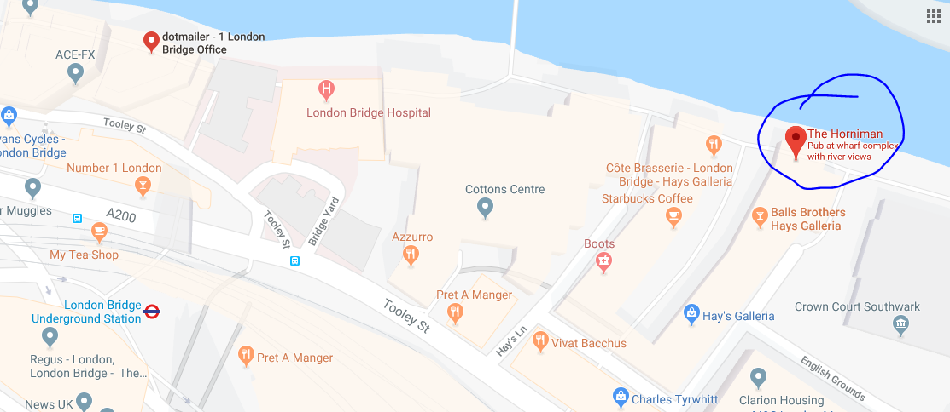
Time for a PowerPint!

Slide 19
Further reading \ watching
Sean Metclafs Blog on AD Security - https://adsecurity.org/
Jessica Payne Blog - https://blogs.technet.microsoft.com/jepayne/author/jessica-payne-msft/
Azure Security - https://azure.microsoft.com/en-gb/blog/topics/security/
Microsoft Security Research Centre - https://blogs.technet.microsoft.com/msrc/
Brian Krebs Blog - https://krebsonsecurity.com/
Black Hat Conference - http://www.blackhat.com/
Lee Holmes Blog - http://www.blackhat.com/
PSConfEU Youtube - https://www.youtube.com/channel/UCxgrI58XiKnDDByjhRJs5fg
US Gov Computer Emergency Readiness Team Alerts- https://www.us-cert.gov/ncas/alerts
Troy Hunt’s blog – https://www.troyhunt.com
Plus many more items too!

